Slide 1
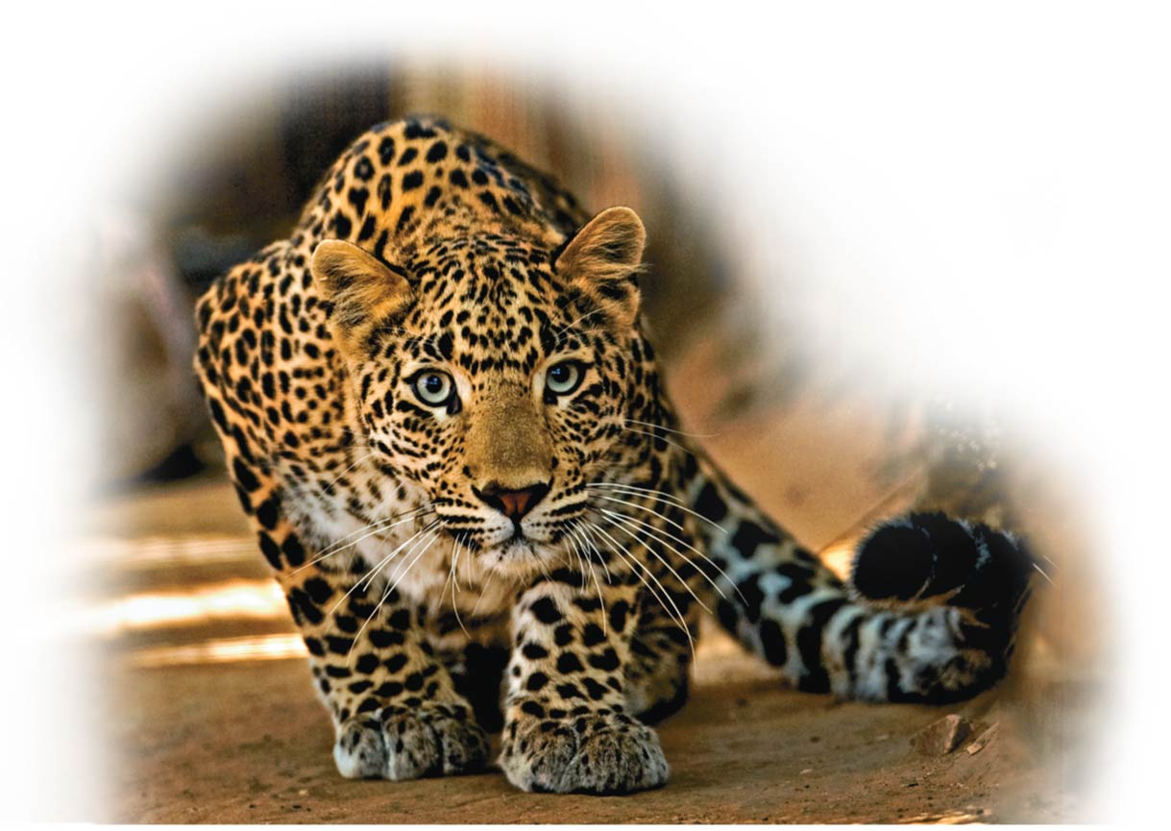
Essential Chemistry for Biology
Unit 1; Chapter 2

Slide 2
Lecture outline
Basic Chemistry
Matters: Elements and Compounds
Atoms (Radiation and life)
Chemical Bonding and Molecules
Chemical Reactions
Water and Life
Structure/Function: Water
Acids, Bases, and PH
Notes:
2

Slide 3
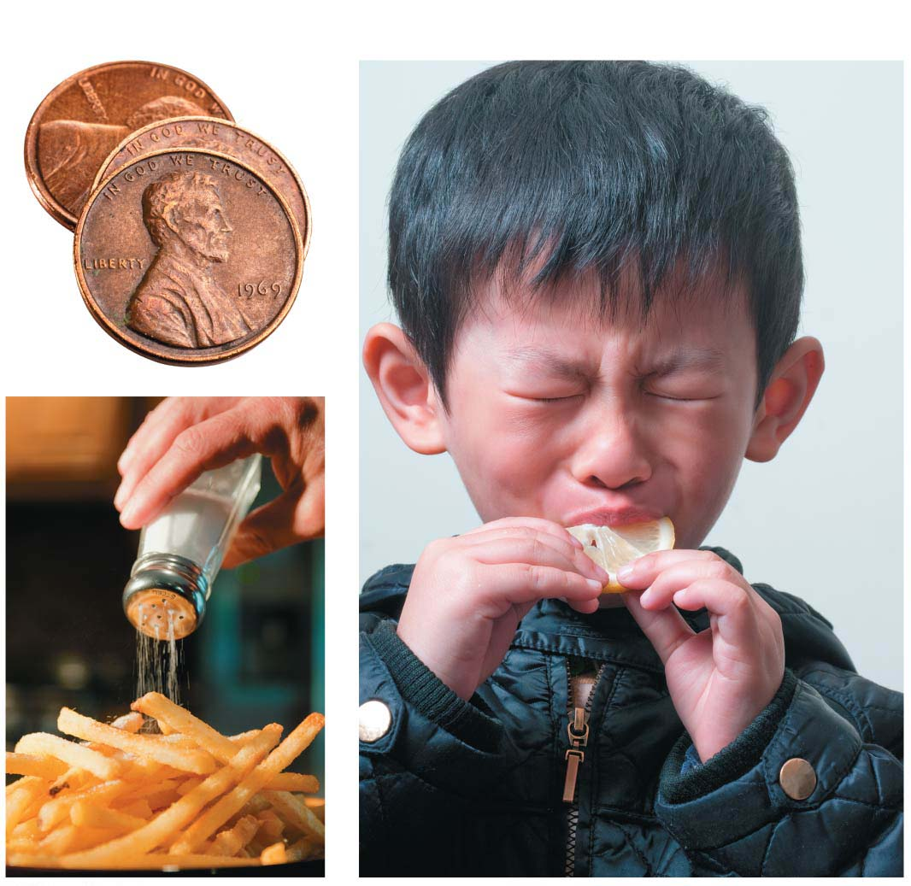
Why Chemistry Matters?

Slide 4
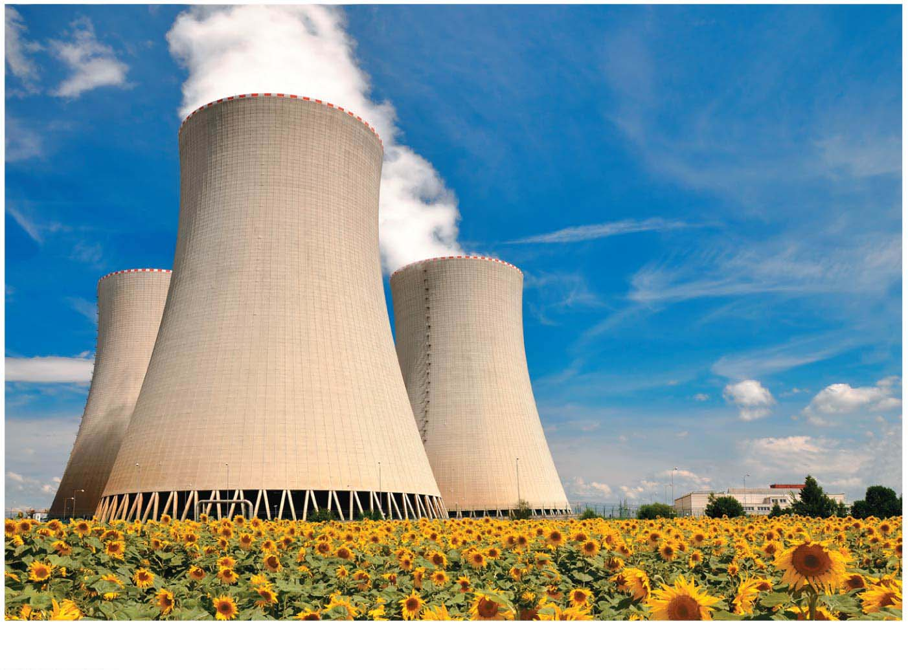
Radioactivity …
Notes:
Figure 2.0-2 Radioactivity: pros and cons of radiation

Slide 5
Biology and Society: Radiation and Health
Radioactivity, the emission of high-energy particles, can
penetrate living tissues and
kill cells by damaging DNA.
Radiation can also be medically beneficial, helping to treat cancer.
Notes:
5

Slide 6
Some Basic Chemistry
Take any biological system apart, and you eventually end up at the chemical level.
Chemical reactions are always occurring in the human body.
Notes:
6

Slide 7
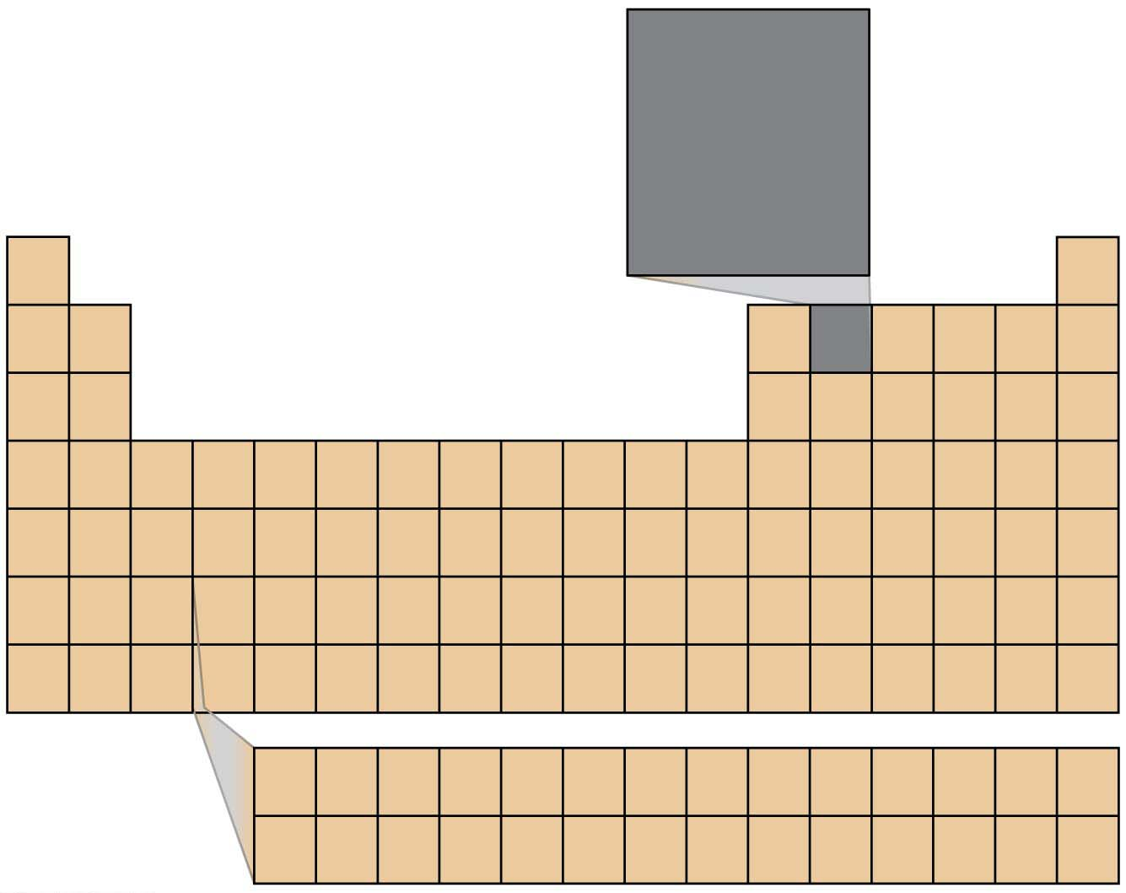
Atomic number
(number of protons)
6
C
Element symbol
Relative atomic mass
(mass of average
atom of that element)
12.01
H
He
Li
Be
B
C
N
O
F
Ne
Na
Mg
AI
Si
P
S
CI
Ar
K
Ca
Sc
Ti
V
Cr
Mn
Fe
Co
Ni
Cu
Zn
Ga
Ge
As
Se
Br
Kr
Rb
Sr
Y
Zr
Nb
Mo
Tc
Ru
Rh
Pd
Ag
Cd
In
Sn
Sb
Te
I
Xe
Cs
Ba
La
Hf
Ta
W
Re
Os
Ir
Pt
Au
Hg
TI
Pb
Bi
Po
At
Rn
Fr
Ra
Ac
Rf
Db
Sg
Bh
Hs
Mt
Ds
Rg
Cn
Ce
Pr
Nd
Pm
Sm
Eu
Gd
Tb
Dy
Ho
Er
Tm
Yb
Lu
Th
Pa
U
Np
Pu
Am
Cm
Bk
Cf
Es
Fm
Md
No
Lr

Slide 8
Matter: Elements and Compounds
Of the naturally-occurring elements, 25 are essential to humans.
Four of these elements make up about 96% of the weight of the body. These four elements are
oxygen (O),
carbon (C),
hydrogen (H), and
nitrogen (N).
Notes:
8

Slide 9
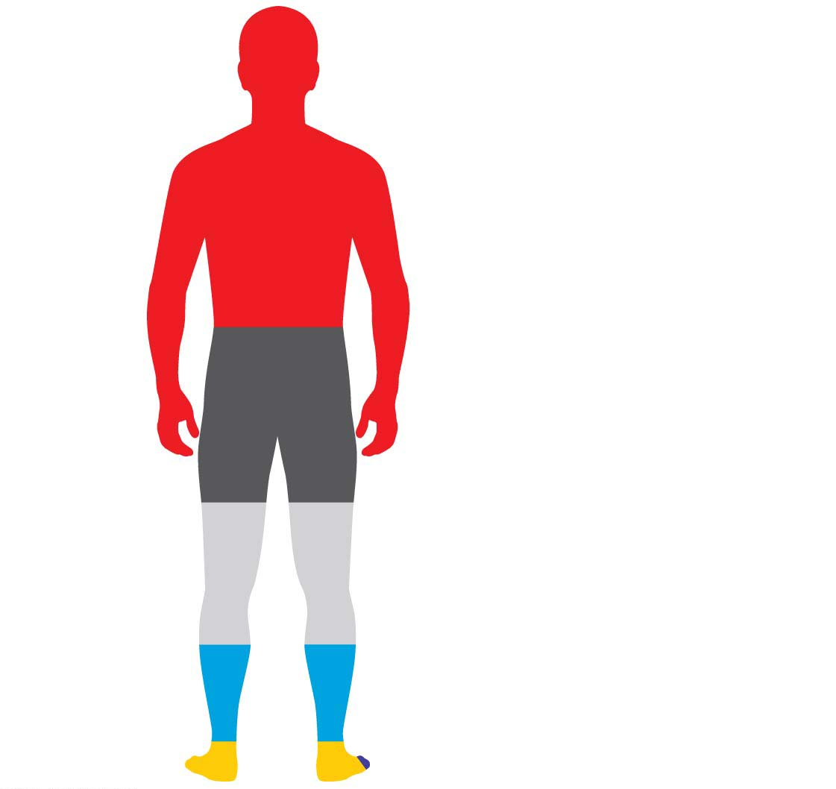
Carbon (C): 18.5%
Oxygen (O):
65.0%
Calcium (Ca): 1.5%
Phosphorus (P): 1.0%
Potassium (K): 0.4%
Sulfur (S): 0.3%
Sodium (Na): 0.2%
Chlorine (Cl): 0.2%
Hydrogen (H):
Magnesium (Mg): 0.1%
9.5%
Trace elements: < 0.01%
Boron (B)
Manganese (Mn)
Nitrogen (N):
Chromium (Cr)
Molybdenum (Mo)
3.3%
Cobalt (Co)
Selenium (Se)
Copper (Cu)
Silicon (Si)
Fluorine (F)
Tin (Sn)
Iodine (I)
Vanadium (V)
Iron (Fe)
Zinc (Zn)
Notes:
Figure 2.2 Chemical composition of the human body

Slide 10
Matter: Elements and Compounds
Much of the remaining 4% is accounted for by 7 elements.
1. Calcium, important for building strong bones and teeth, is found abundantly in dairy products, sardines, and green, leafy vegetables.
2. Phosphorus, a component of DNA, can be obtained by eating eggs, beans, and nuts.
Notes:
10

Slide 11
Matter: Elements and Compounds
Trace elements are
required in only very small amounts and
essential for life.
An iodine deficiency causes goiter.
Fluorine
is added to dental products and drinking water and
helps to maintain healthy bones and teeth.
Notes:
11

Slide 12
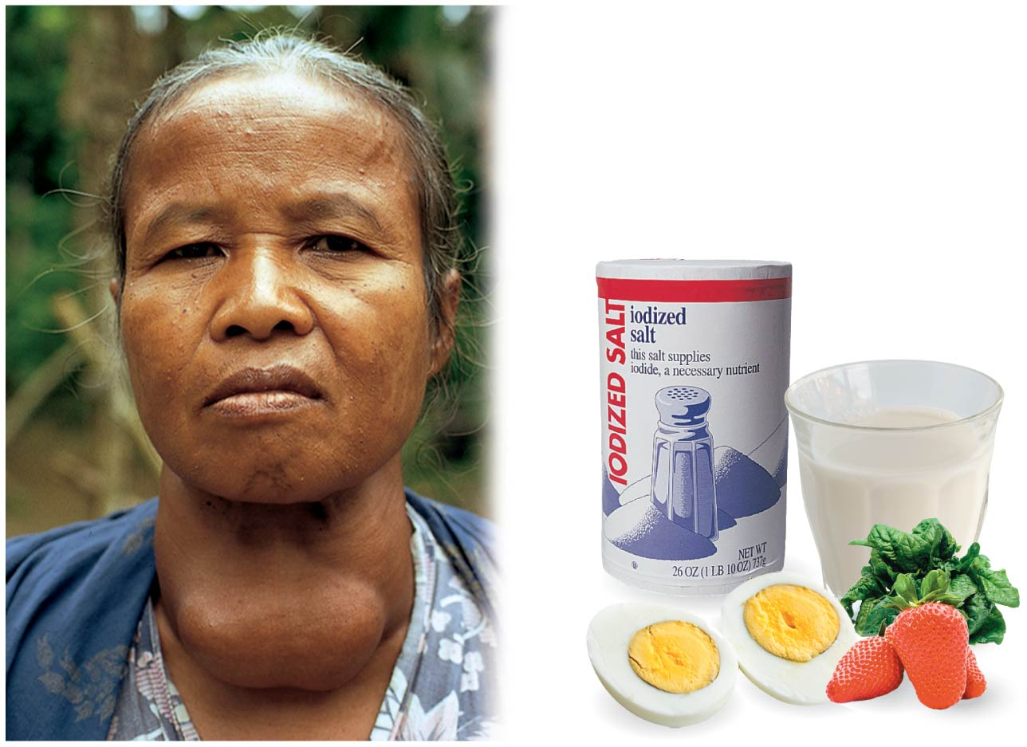
Diet and goiter
(Iodine deficiency)
（Goiter: an enlargement of the
thyroid gland; 甲状腺肿；“大脖子病”)
Notes:
Figure 2.3 Diet and goiter

Slide 13
Matter: Elements and Compounds
Elements can combine to form compounds, substances that contain two or more elements in a fixed ratio.
Common compounds include
NaCl (table salt) and
H₂O (water).
Notes:
13

Slide 14
The Structure of Atoms
Atoms are composed of subatomic particles.
A proton is positively charged and has mass.
An electron is negatively charged and has no mass.
A neutron is electrically neutral and has mass.
When an atom has an equal number of protons and electrons,
its net electrical charge is zero and
the atom is neutral.
Notes:
14

Slide 15
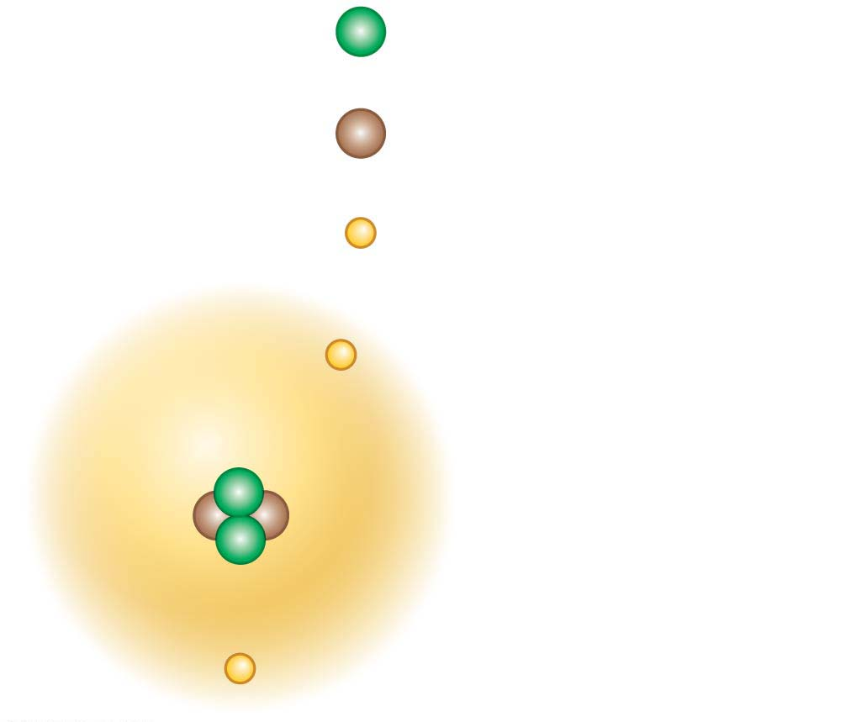
A simplified model of a helium atom
2
+
Protons
Nucleus
2
Neutrons
Nucleus
2
−
Electrons
−
Electron cloud
containing two
electrons
+
+
−
Notes:
Figure 2.4 A simplified model of a helium atom

Slide 16

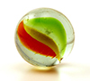
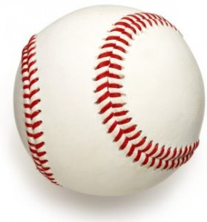
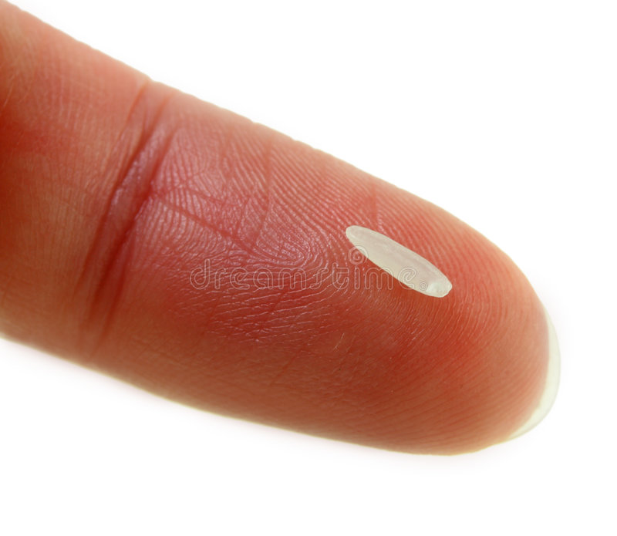
If this were the volume of the atom… | then this would be the volume of the nucleus.
If protons and neutrons had the mass of baseballs… | then electrons would have the mass of a grain of rice.

Slide 17
Isotopes （同位素）
have the same number of protons and electrons but differ in their number of neutrons.
Some are stable isotopes, but some are radioactive isotopes.
iso = equal (isotope: an element having the same number of protons and
electrons but a different number of neutrons)
Notes:
17

Slide 18
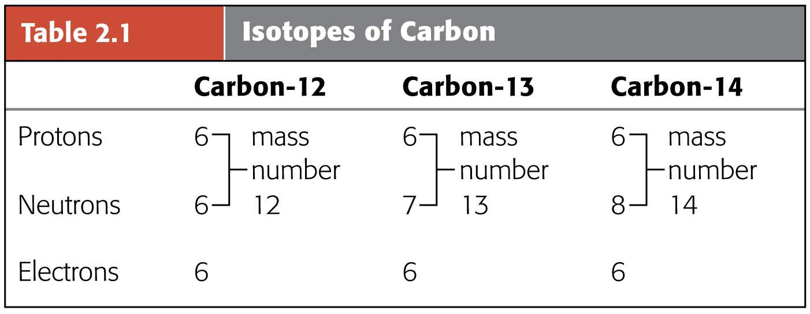
Isotopes of Carbon
99%
~1%
Trace amount
Notes:
Table 2.1 Isotopes of carbon

Slide 19
Isotopes
A radioactive isotope is one in which the nucleus decays spontaneously.
Radiation from decaying isotopes can
damage cellular molecules and
pose serious health risks.
Natural sources of radiation can also pose a threat.
Radon （氡气）, a radioactive gas, is a carcinogen that can cause lung cancer.
Radon testing is a standard procedure before a house is bought or sold.
Notes:
19

Slide 20
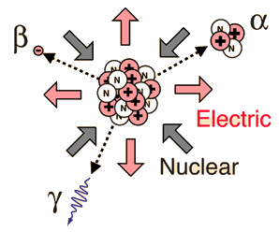
Radioactive decays/Nucleus decays/Radioactivity is the process by which an unstable atomic nucleus loses energy by emitting radiation, such as an alpha particle, beta particle and gamma ray.

Slide 21
The Process of Science: Can Radioactive Tracers Help Detect Brain Diseases?
Cells use radioactive isotopes the same way they use nonradioactive isotopes of the same element.
Once the cell takes up a radioactive isotope, the location and concentration of the isotope can be detected because of the radiation it emits.
This makes radioactive isotopes useful as tracers for monitoring living organisms.
Notes:
21

Slide 22
The Process of Science: Can Radioactive Tracers Help Detect Brain Diseases?
A medical diagnostic tool called a PET scan works by detecting small amounts of radiation emitted by radioactive materials that were purposefully introduced into the body.
Notes:
22

Slide 23
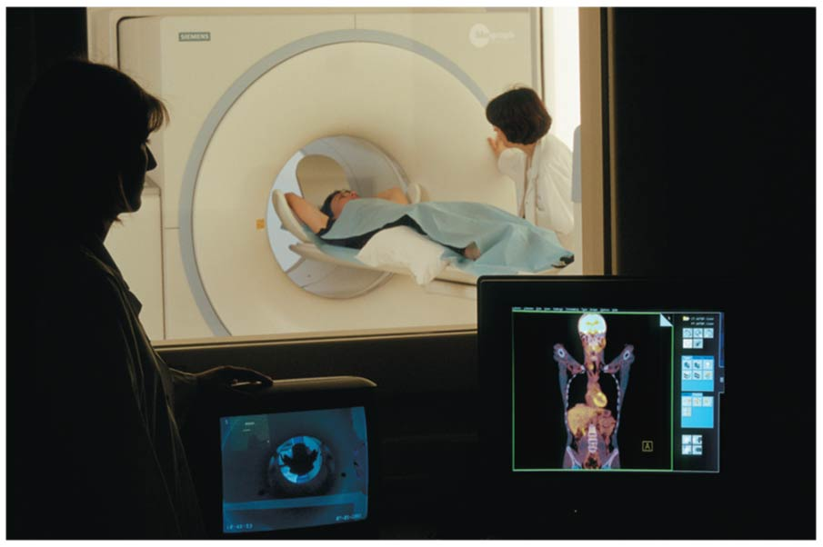
A PET Scan
Notes:
Figure 2.5 A PET scan

Slide 24
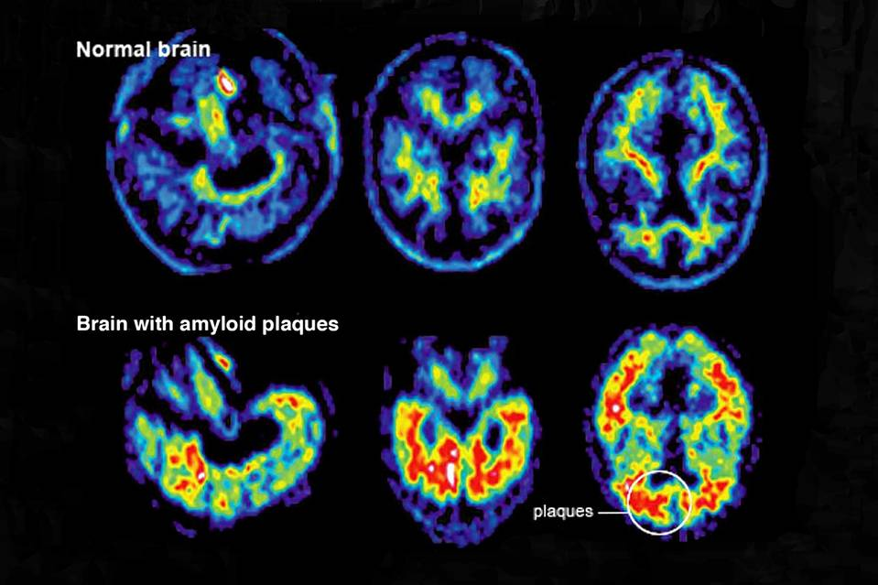
Florbetapir (fluorine-18)
Binds to amyloid plaques
PET scan
Amyloid plaques is a biomarker of Alzheimer’s Diseases.

Slide 25
Evolution Connection: Radioactivity as an Evolutionary Clock
The natural process of radioactive decay can be used to obtain important data about the evolutionary history of life on Earth.
Fossils are reliable chronological records（序时记录） of life because we can determine their ages through radiometric dating, which is based on the decay of radioactive isotopes.
Chronology: chrono-times, logy-scientific study, the science of arranging events in their order of occurrence in time.
Notes:
25

Slide 26
Evolution Connection: Radioactivity as an Evolutionary Clock
Carbon-14
is present in trace amounts in the environment and
Radiocarbon dating method is based on the fact that radiocarbon is constantly being created in the atmosphere by the interaction of cosmic rays with atmospheric nitrogen.
is a radioactive isotope with a half-life of 5,700 years.
Half-life (symbol t1⁄2) is the time required for a quantity to reduce to half its initial value.
Notes:
26

Slide 27
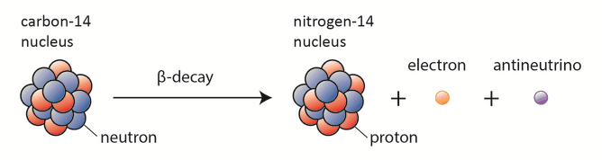

Slide 28
Evolution Connection: Radioactivity as an Evolutionary Clock
A living organism assimilates the different isotopes of an element in proportions that reflect their relative abundances in the environment.
A fossil’s age can be estimated by measuring the ratio of the two isotopes to learn how many half-life reductions have occurred since it died.
Notes:
28

Slide 29
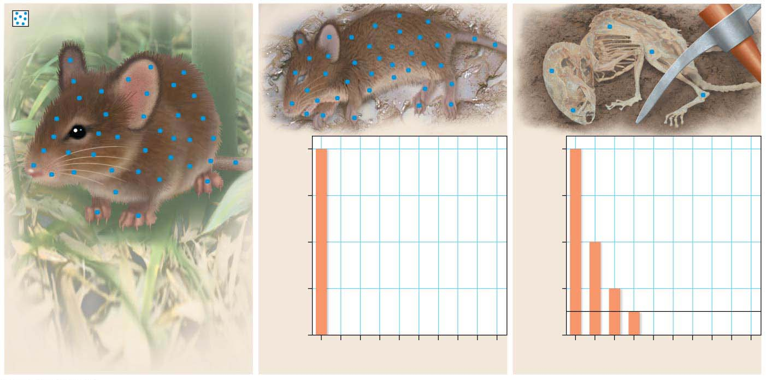
Carbon-14
Carbon-14 radioactivity (as % of
living organism’s C-14 to C-12 ratio)
100
Carbon-14 radioactivity (as % of
living organism’s C-14 to C-12 ratio)
100
75
75
50
50
25
25
0
0
0
5.7
11.4
17.1
22.8
28.5
34.2
39.9
45.6
51.3
0
5.7
11.4
17.1
22.8
28.5
34.2
39.9
45.6
51.3
Time (thousands of years)
Time (thousands of years)
Notes:
Figure 2.17 Radiometric dating

Slide 30
Evolution Connection: Radioactivity as an Evolutionary Clock
Using such techniques, scientists can
estimate the ages of fossils from around the world and
place them in an ordered sequence called the fossil record.
Notes:
30

Slide 31
Chemical Bonding and Molecules
Only electrons are directly involved in chemical reactions.
The number of electrons in an atom determines the chemical properties of that atom.
Chemical reactions enable atoms to transfer or share electrons.
These interactions usually result in atoms staying close together, held by attractions called chemical bonds.
Notes:
31

Slide 32
Ionic Bonds
When an atom loses or gains electrons, it becomes electrically charged.
Ions are atoms or molecules that are electrically charged as a result of gaining or losing electrons.
Ionic bonds are formed between oppositely charged ions.
Compounds, such as table salt, that are held together by ionic bonds, are called ionic compounds.
Notes:
32

Slide 33
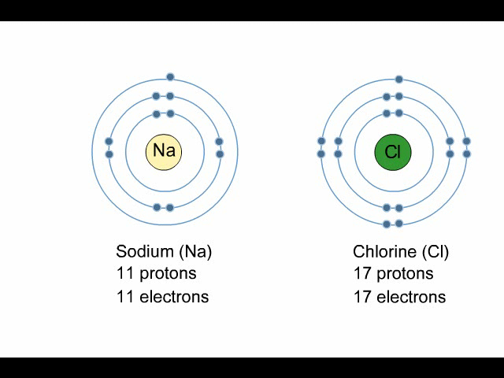
Animation: Ionic Bonds
Notes:
33

Slide 34
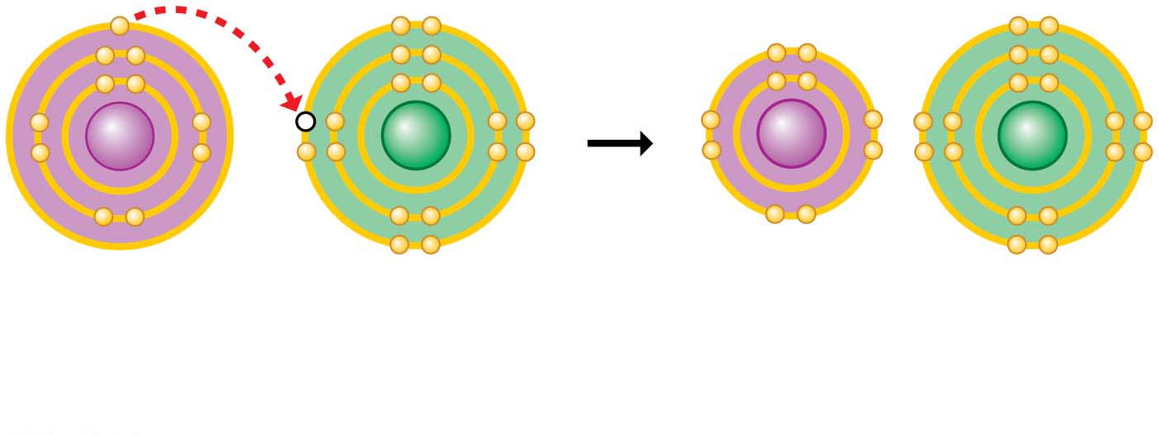
Electron transfer and ionic bonding
Na
Cl
Na⁺
Cl⁻
Na
Sodium atom
Cl
Chlorine atom
Na⁺
Sodium ion
Cl⁻
Chloride ion
Sodium chloride (NaCl)
Notes:
Figure 2.6-s2 Electron transfer and ionic bonding (step 2)

Slide 35
Covalent Bonds
A covalent bond forms when two atoms share one or more pairs of electrons.
Covalent bonds
are the strongest of the various bonds and
hold atoms together in a molecule.
Notes:
35

Slide 36
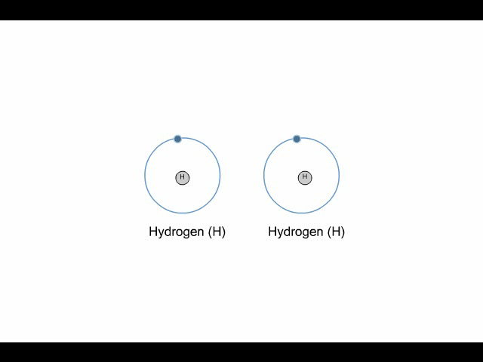
Animation: Covalent Bonds
Notes:
36

Slide 37
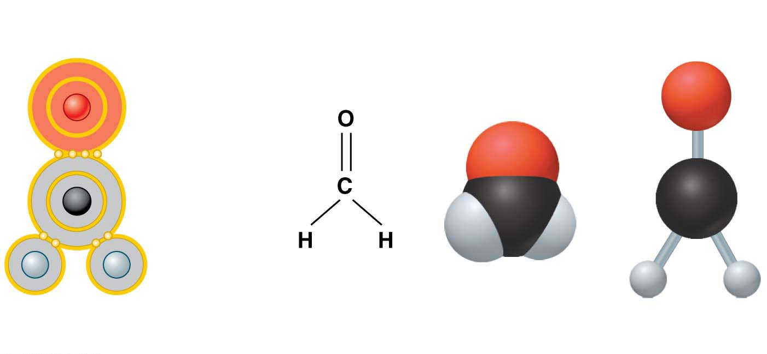
Alternative ways to represent a molecule
Electron
configuration
Structural
formula
Space-filling
model
Ball-and-stick
model
O
O
Double
bond
C
C
Single
bond
H
H
H
H
Name (molecular formula) : Formaldehyde (CH₂O)
Notes:
Figure 2.7 Alternative ways to represent a molecule

Slide 38
Hydrogen Bonds
Hydrogen bonds are weak bonds formed between water molecules.
A molecule of water (H₂O) consists of two hydrogen atoms joined to one oxygen atom by single covalent bonds, but the electrons are not shared equally between the oxygen and hydrogen atoms.
This causes water to be a polar molecule, one with an uneven distribution of charge.
Notes:
38

Slide 39
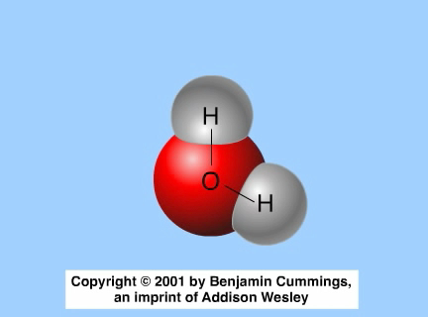
Animation: Water Structure
Notes:
39

Slide 40
Hydrogen Bonds
The polarity of water results in weak electrical attractions between neighboring water molecules.
These weak attractions are called hydrogen bonds.
Notes:
40

Slide 41
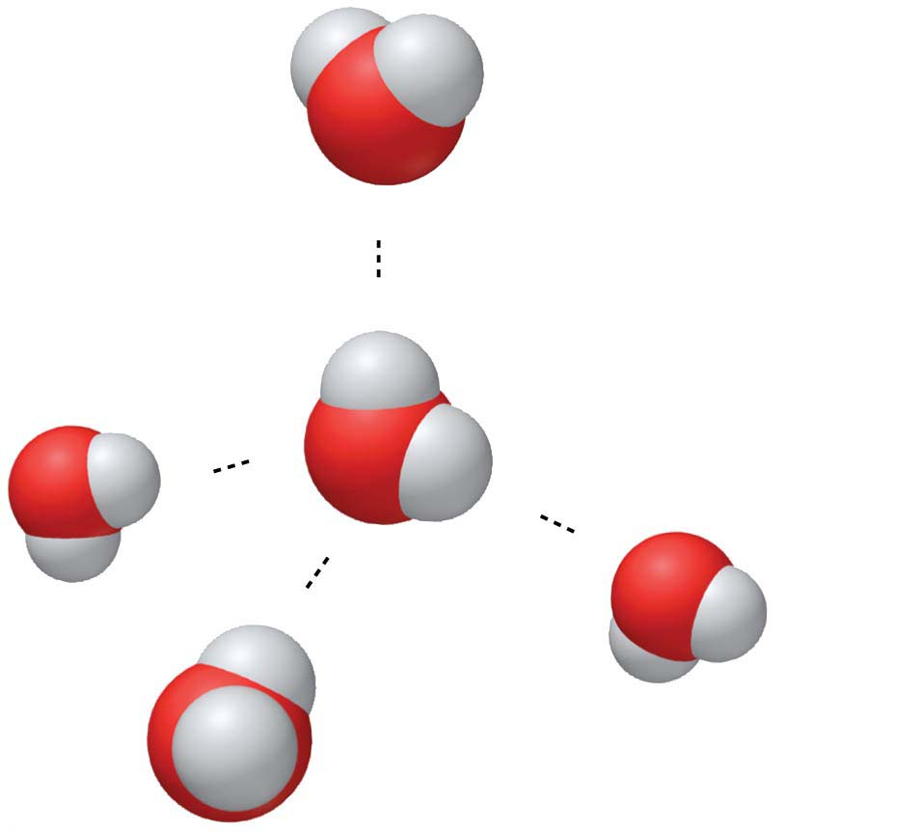
Hydrogen bonding in water
(−)
Hydrogen bond
(+)
H
Slightly positive
charge
(−)
O
H
Slightly negative
charge
(+)
(+)
(−)
(−)
(+)
Notes:
Figure 2.8 Hydrogen bonding in water

Slide 42
Chemical Reactions
Cells constantly rearrange molecules by
breaking existing chemical bonds and
forming new ones.
Such changes in the chemical composition of matter are called chemical reactions.
Notes:
42

Slide 43
Chemical Reactions
Chemical reactions include
reactants, the starting materials, and
products, the end materials.
Chemical reactions
can rearrange matter
but cannot create or destroy matter.
Substrates (底物):the reactants which are consumed during a catalytic or enzymatic reaction
Notes:
43

Slide 44
Water and Life
Life on Earth began in water and evolved there for 3 billion years before spreading onto land.
Modern life is still tied to water.
Your cells are composed of 70–95% water.
The abundance of water is a major reason that Earth is habitable.
Notes:
44

Slide 45
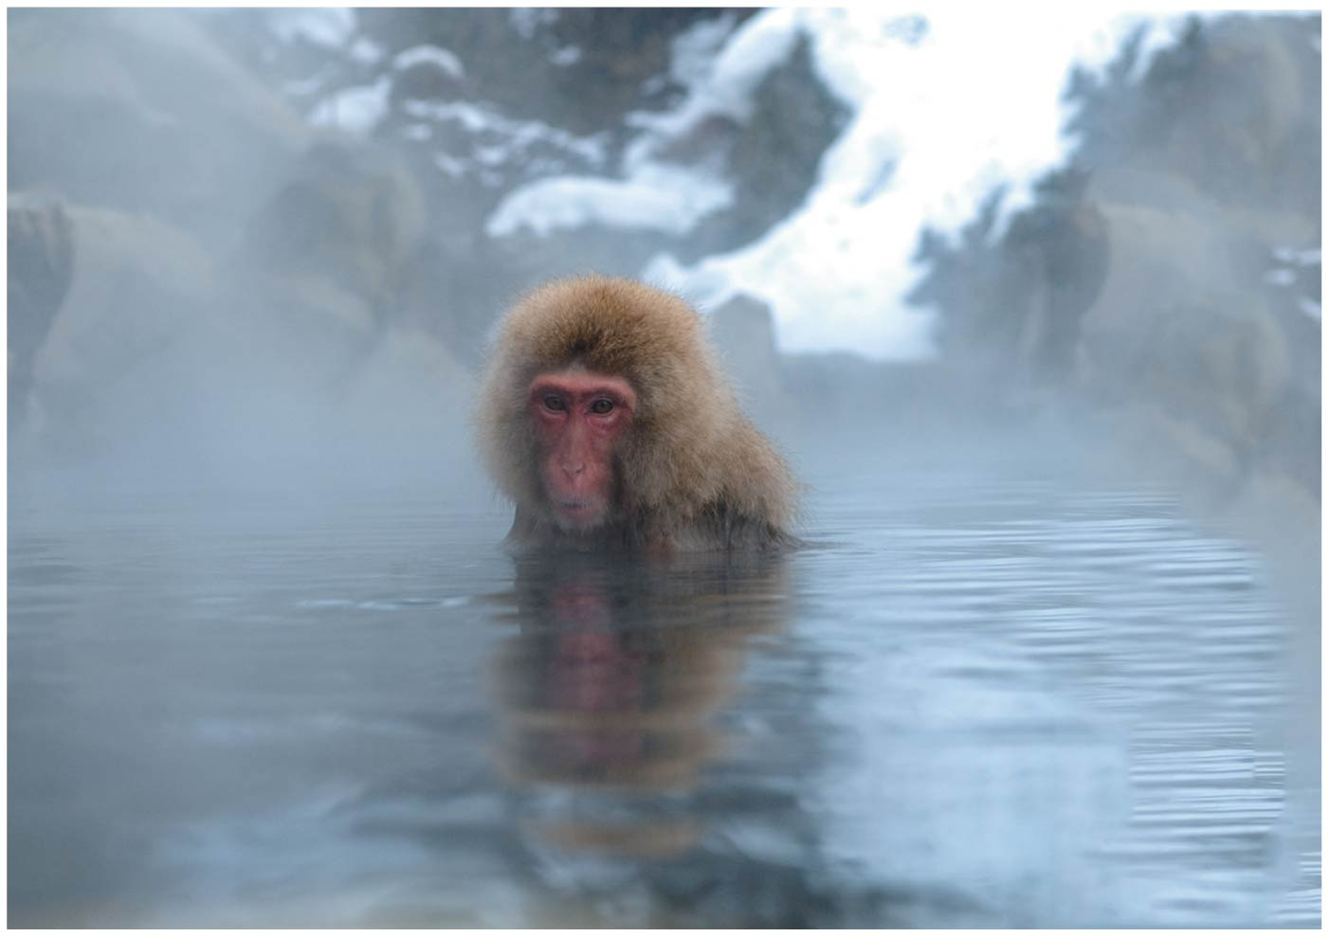
Figure 2.9
Notes:
Figure 2.9 A watery world

Slide 46
Structure/Function: Water
The polarity of water molecules and the hydrogen bonding that results explain most of water’s life-supporting properties.
We will explore four of those properties:
the cohesive nature of water,
the ability of water to moderate temperature,
the biological significance of ice floating, and
the versatility of water as a solvent.
Notes:
46

Slide 47
The Cohesion of Water
Water molecules stick together as a result of hydrogen bonding.
This tendency of molecules of the same kind to stick together is called cohesion and is much stronger for water than for most other liquids.
Trees depend on cohesion to help transport water from their roots to their leaves.
Notes:
47

Slide 48
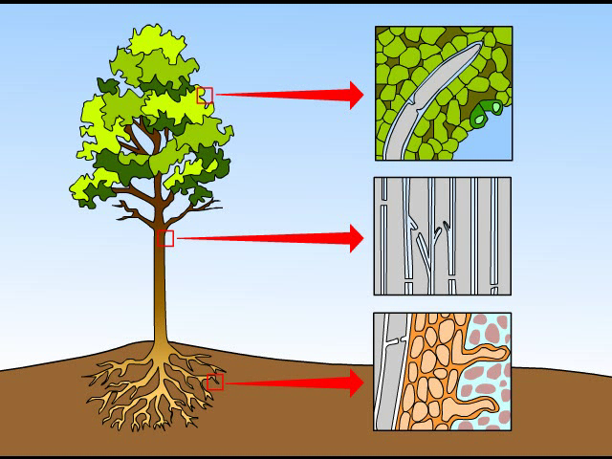
Animation: Water Transport
Notes:
48

Slide 49
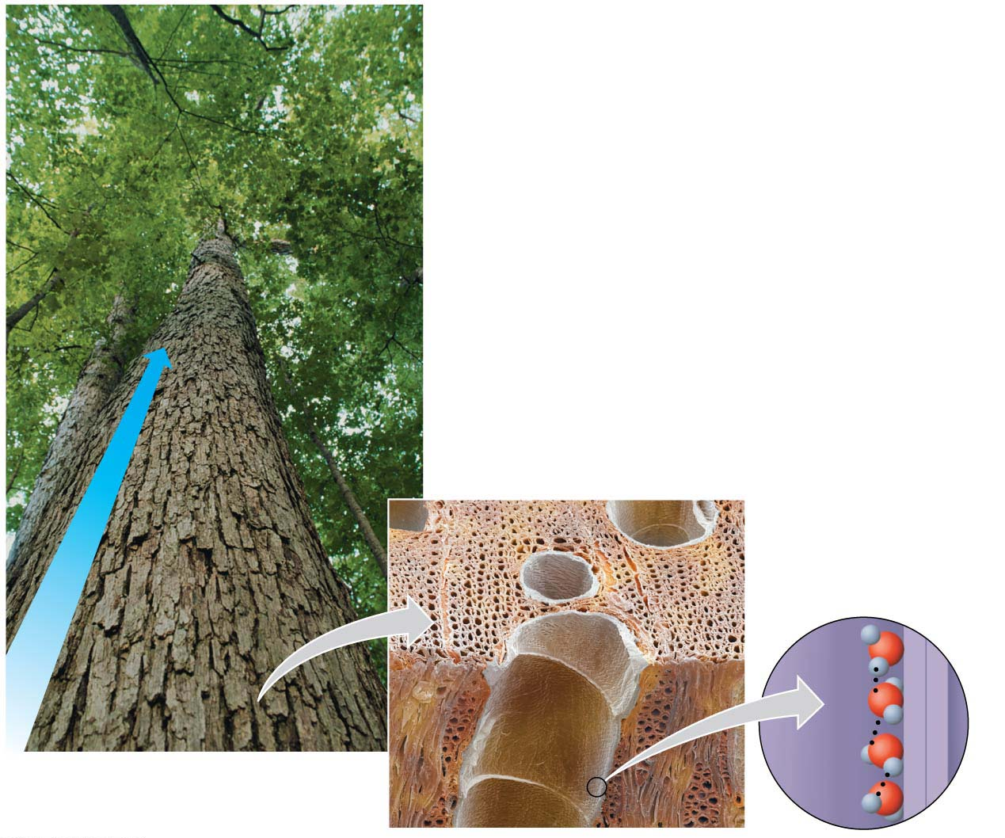
Cohesion and water transport in plants
Evaporation from the leaves
Microscopic water-
conducting tubes
Flow of water
Cohesion due to
hydrogen bonds
between water
molecules
Colorized
SEM
Notes:
Figure 2.10 Cohesion and water transport in plants

Slide 50
The Cohesion of Water
Surface tension is a measure of how difficult it is to stretch or break the surface of a liquid.
Hydrogen bonds give water unusually high surface tension and make water behave as though it were coated with an invisible film.
Notes:
50

Slide 51
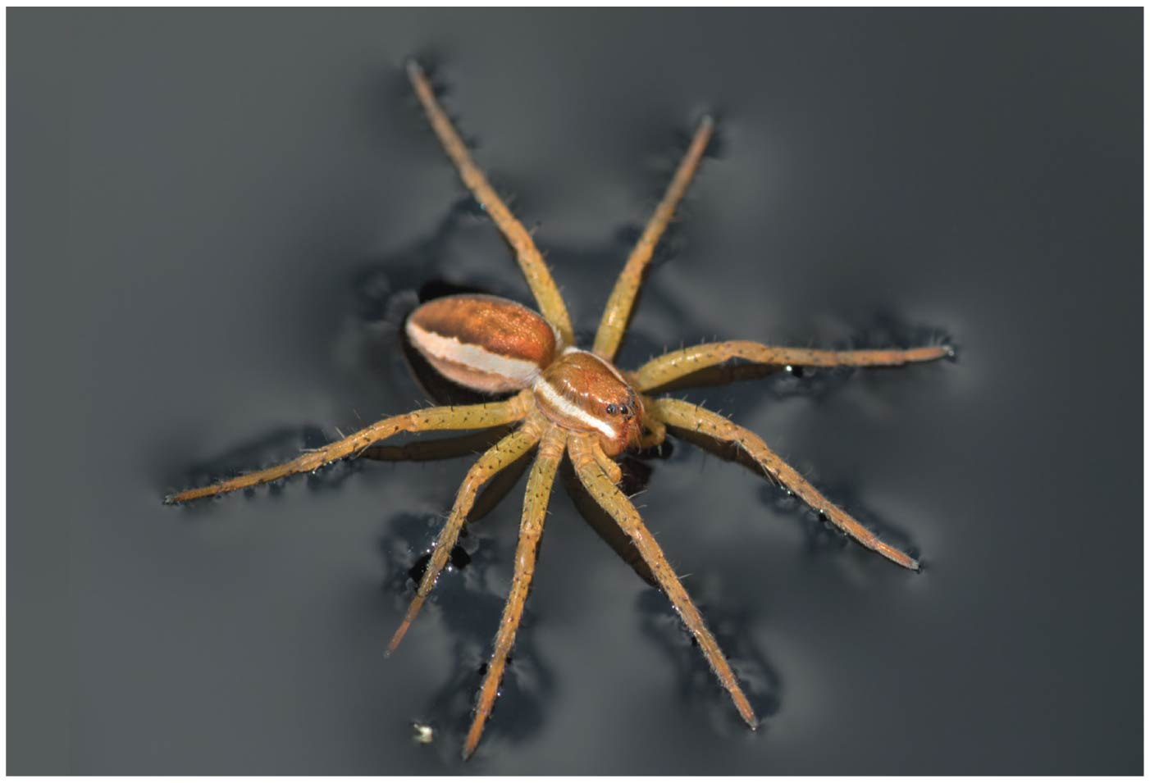
Notes:
Figure 2.11 A raft spider walking on water

Slide 52
How Water Moderates Temperature
Water can moderate temperatures.
Earth’s giant water supply enables temperatures on the planet to stay within limits that permit life by
storing a huge amount of heat from the sun during warm periods and
giving off heat that warms the air during cold periods.
Evaporative cooling occurs when a substance evaporates and the surface of the liquid remaining behind cools down.
Notes:
52

Slide 53
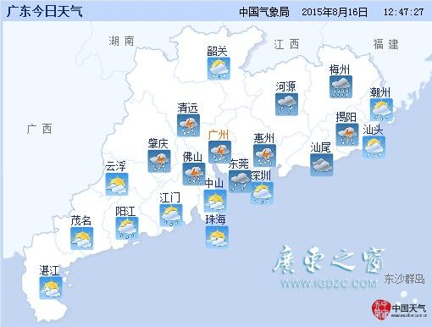
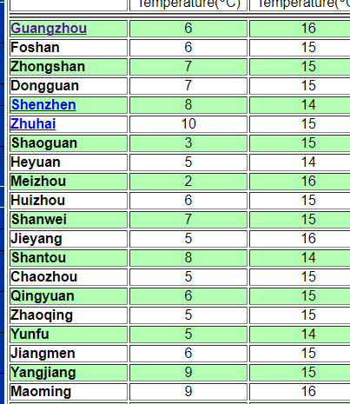
Coastal areas have milder climates than inland regions

Slide 54
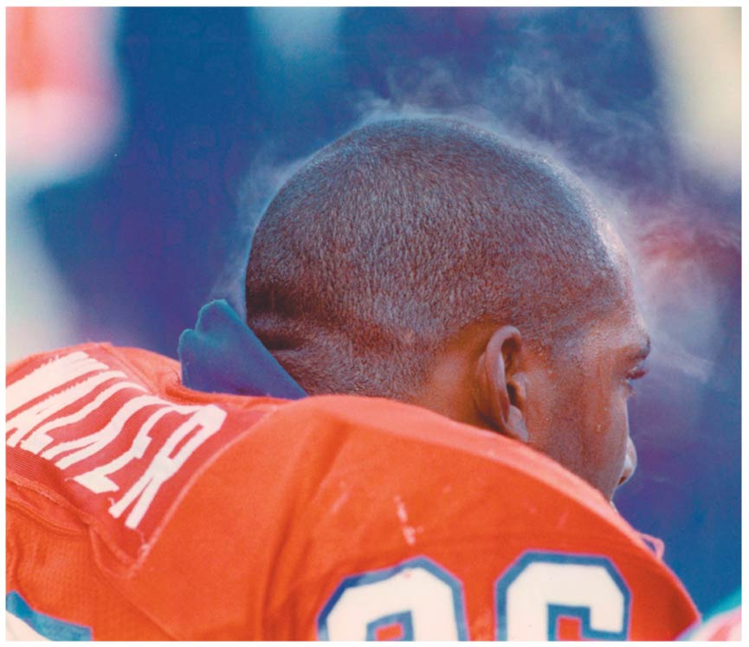
Sweating as a mechanism of evaporative cooling
Notes:
Figure 2.12 Sweating as a mechanism of evaporative cooling

Slide 55
The Biological Significance of Ice Floating
When a deep body of water cools and a layer of ice forms on top, the floating ice acts as an insulating “blanket” over the liquid water, allowing life to persist under the frozen surface.
If ice did not float, ponds, lakes, and even the oceans would freeze solid.
Notes:
55

Slide 56
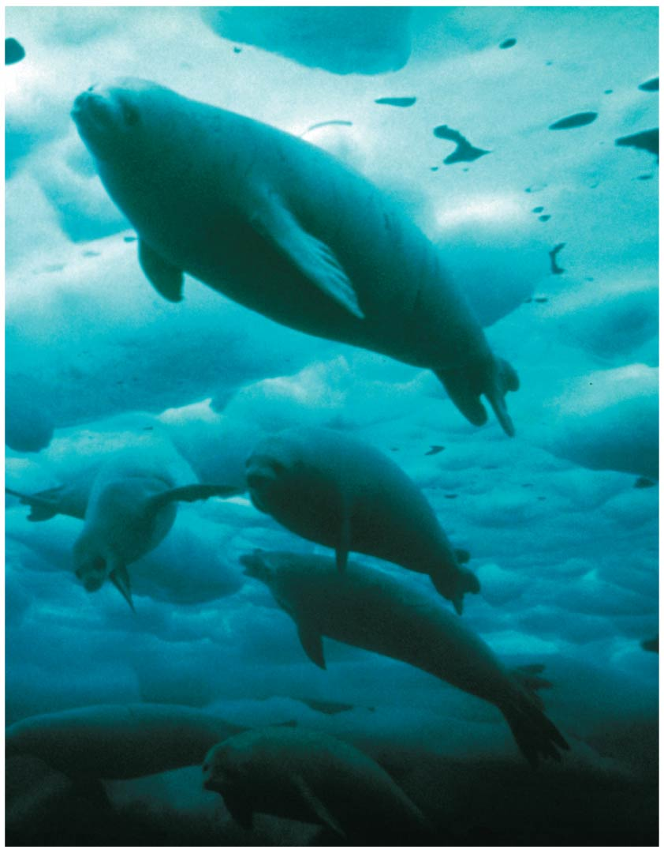
Notes:
Figure 2.13-2 Why ice floats (part 2: floating ice)

Slide 57
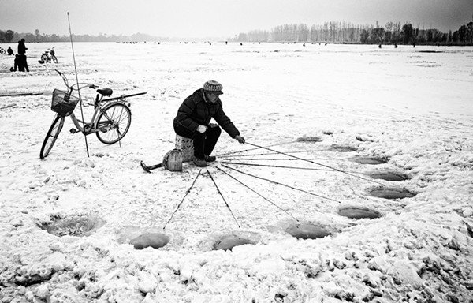

Slide 58
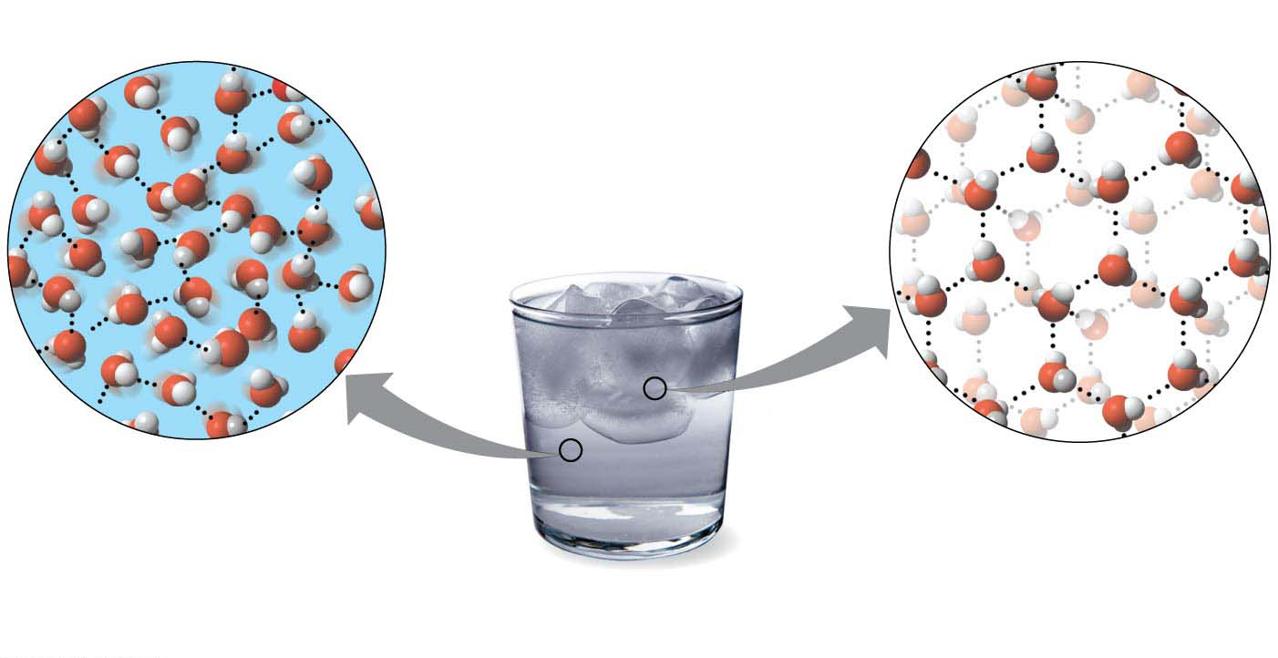
Why ice floats?
Hydrogen bond
Liquid water
Hydrogen bonds constantly
break and re-form.
Ice
Stable hydrogen bonds
keep molecules at a fixed distance apart, making ice less dense than water.
Notes:
Figure 2.13-1 Why ice floats (part 1: liquid water and ice)

Slide 59
Water as the Solvent of Life
A solution is a liquid consisting of a homogeneous mixture of two or more substances.
The dissolving agent is the solvent.
The dissolved substance is the solute.
When water is the solvent, the result is an aqueous solution.
Notes:
59

Slide 60
Water as the Solvent of Life
Water can dissolve an enormous variety of solutes necessary for life, providing a medium for chemical reactions.
When water dissolves salt ions, each ion becomes surrounded by oppositely charged regions of water molecules.
Notes:
60

Slide 61
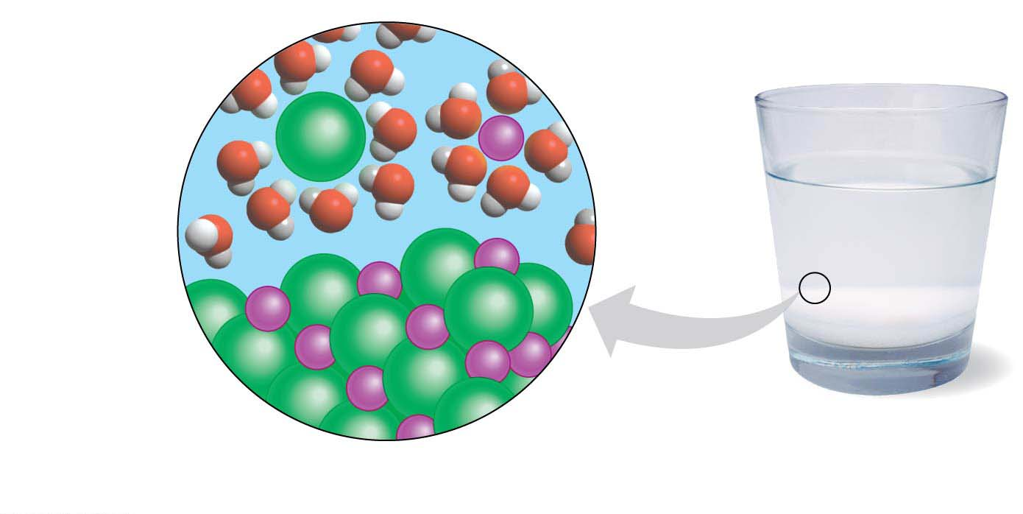
A crystal of table salt (NaCl) dissolving in water
Sodium ion
in solution
Chloride ion
in solution
Cl⁻
Na⁺
Cl⁻
Na⁺
Salt crystal
Notes:
Figure 2.14 A crystal of table salt (NaCl) dissolving in water

Slide 62
Acids, Bases, and pH
A chemical compound that releases H⁺ to a solution is an acid.
A compound that accepts H⁺ and removes them from solution is a base.
To describe the acidity of a solution, chemists use the pH scale, a measure of the hydrogen ion (H⁺) concentration in a solution.
The scale ranges from 0 (most acidic) to 14 (most basic)
Each pH unit represents a tenfold change in the concentration of H⁺.
Notes:
62
Here we will look at aqueous solutions in more detail.

Slide 63
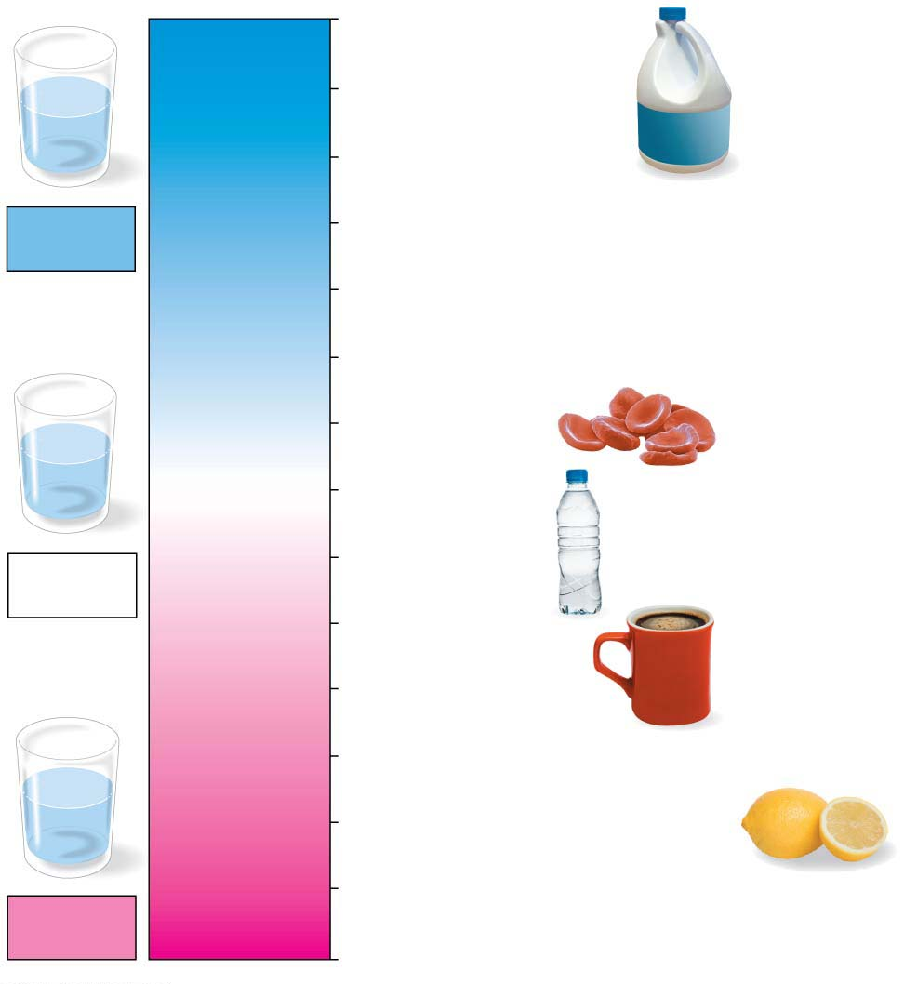
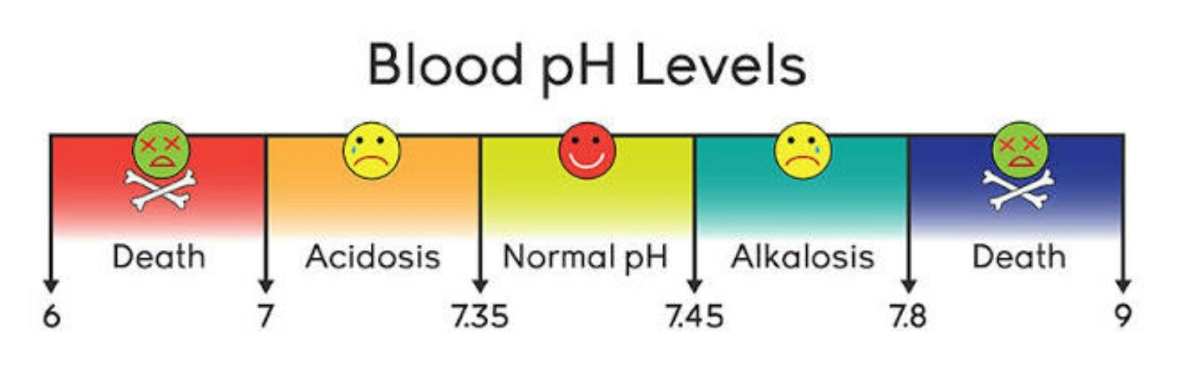
14
Oven cleaner
OH⁻
Lower H⁺ concentration
13
Household bleach
OH⁻
OH⁻
OH⁻
H⁺
OH⁻
OH⁻
H⁺
12
Household ammonia
Basic
solution
11
Milk of magnesia
10
9
Seawater
8
OH⁻
H⁺
Human blood
OH⁻
OH⁻
H⁺
[H⁺] = [OH⁻]
7
Pure water
H⁺
OH⁻
H⁺
Neutral
solution
6
Urine
Greater H⁺ concentration
5
Black coffee
4
Tomato juice
3
Grapefruit juice, soft drink
H⁺
H⁺
2
Lemon juice, stomach acid
OH⁻
H⁺
H⁺
H⁺
H⁺
OH⁻
1
Battery acid
Acidic
solution
0
pH scale
Notes:
Figure 2.15 The pH scale

Slide 64
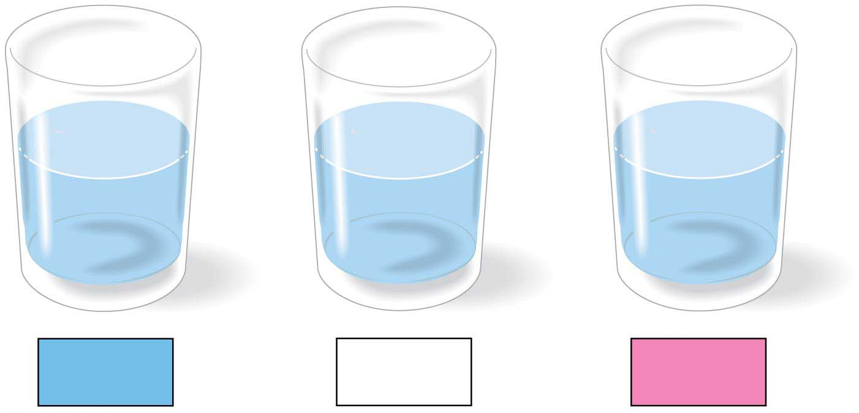
The pH Scale
OH⁻
OH⁻
OH⁻
OH⁻
H⁺
H⁺
H⁺
OH⁻
H⁺
OH⁻
H⁺
OH⁻
H⁺
OH⁻
OH⁻
H⁺
OH⁻
H⁺
H⁺
OH⁻
H⁺
H⁺
OH⁻
H⁺
Basic
solution
Neutral
solution
Acidic
solution
Notes:
Figure 2.15-1 The pH scale (part 1: detail)

Slide 65
Acids, Bases, and pH
Buffers are substances that minimize changes in pH. Buffers
accept H⁺ when they are in excess and
donate H⁺ when they are depleted.
When CO₂ dissolves in seawater, it reacts with water to form an acid, which
lowers ocean pH and
can greatly change marine environments.
Notes:
65

Slide 66
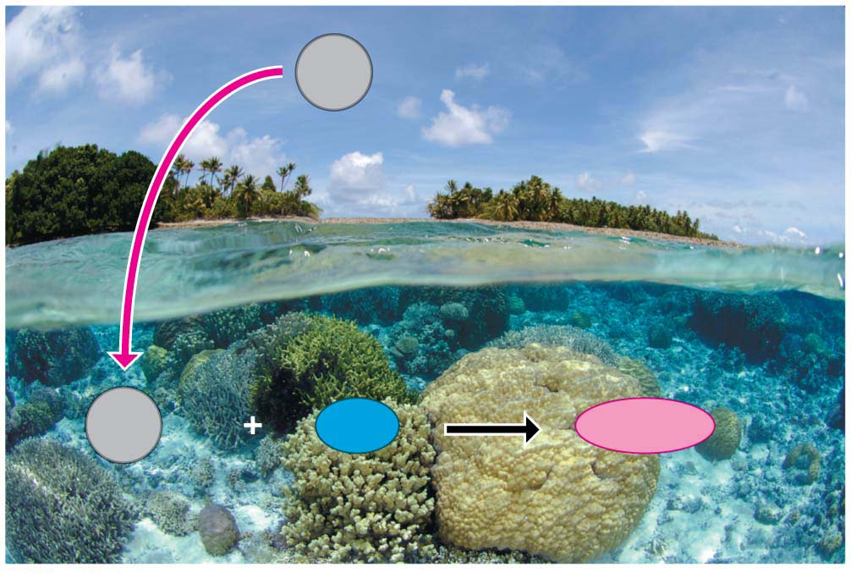
CO₂
Carbon dioxide
CO₂
+
H₂O
H₂CO₂
Carbon
dioxide
Water
Carbonic acid
Notes:
Figure 2.16 Ocean acidification by atmospheric CO₂

Slide 67
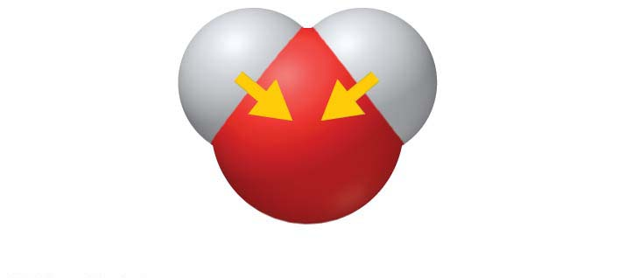
(slightly +)
(slightly +)
H
H
O
(slightly −)
Notes:
Figure 2.UN02 In-text figure, water polarity, p. 28

Slide 68
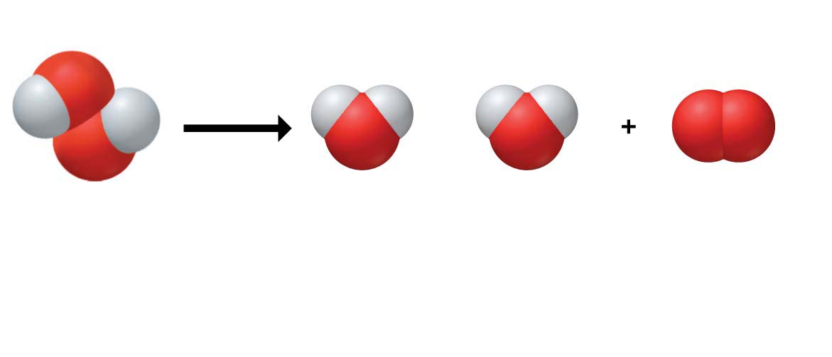
2 H₂O₂
2 H₂O
O₂
+
Hydrogen
peroxide
Water
Oxygen
gas
Reactants
Products
Notes:
Figure 2.UN03 In-text figure, chemical reaction, p. 28

Slide 69
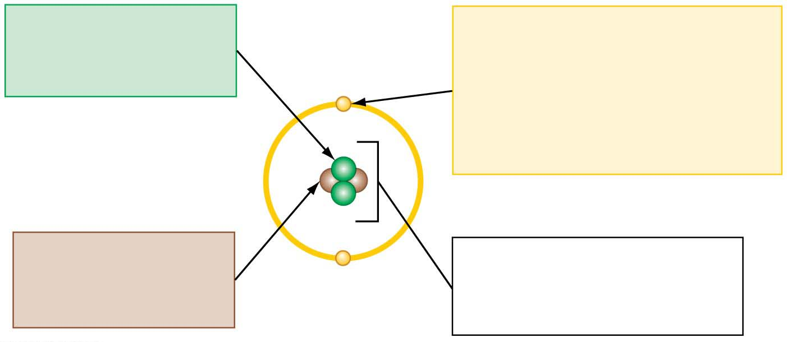
Protons
Electrons
• Positive charge
• Negative charge
• Determine element
• Participate in chemical
reactions
−
• Outer-shell electrons
determine chemical behavior
+
+
Neutrons
−
Nucleus
• No charge
Atom
• Consists of neutrons and
protons
• Determine isotope
Notes:
Figure 2.UN04 Summary of key concepts: atoms

Slide 70
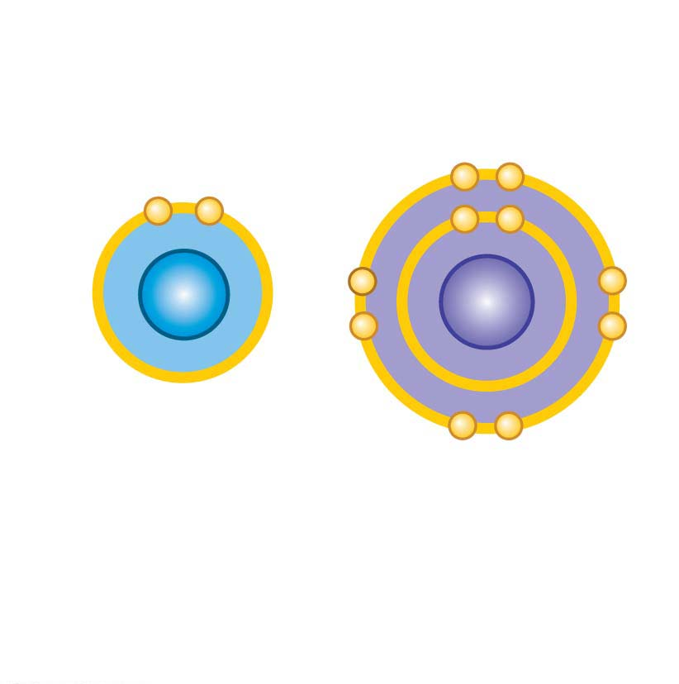
Attraction between oppositely
charged ions holds the ions in
an ionic bond.
Li⁺
F⁻
Lithium ion
Fluoride ion
Lithium fluoride (ionic compound)
Notes:
Figure 2.UN05 Summary of key concepts: ionic bond

Slide 71
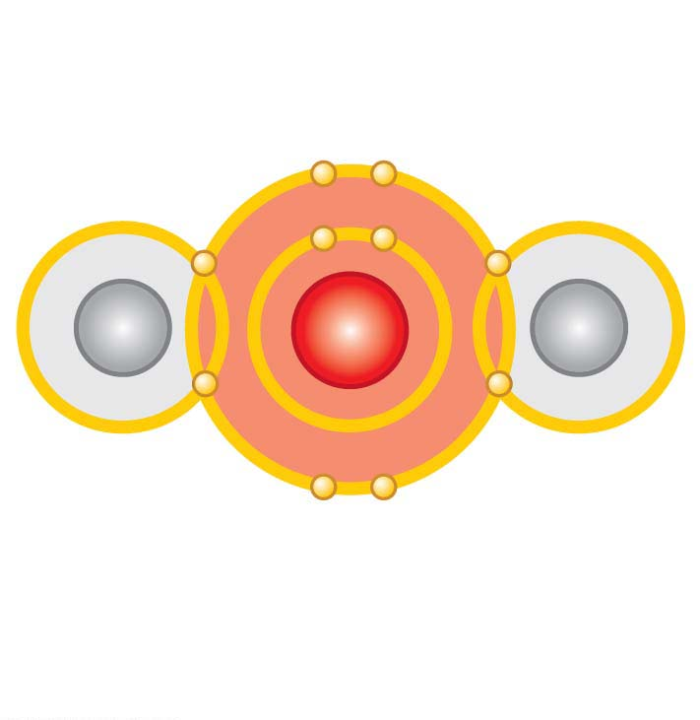
Electron sharing
H
O
H
Atoms joined into a molecule
via covalent bonds
Notes:
Figure 2.UN06 Summary of key concepts: covalent bond

Slide 72
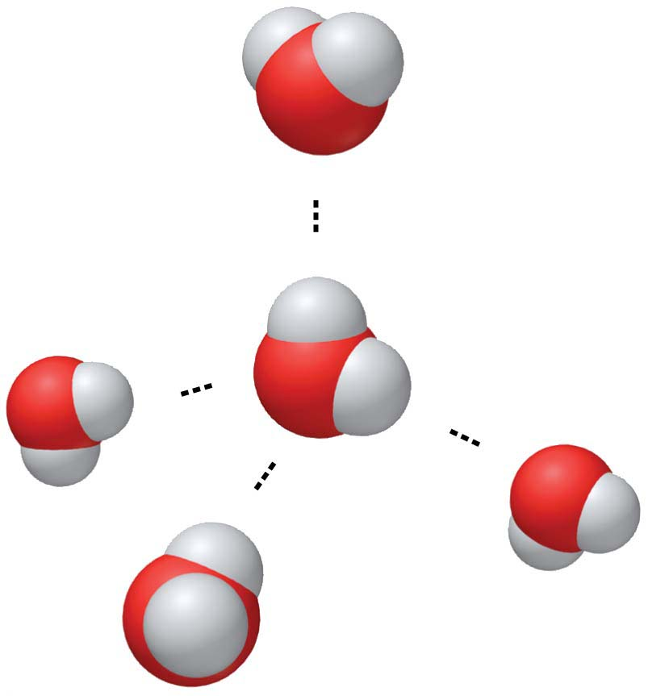
(−)
Hydrogen
bond
(+)
H
(−)
O
H
(+)
(+)
(−)
(−)
(+)
Notes:
Figure 2.UN07 Summary of key concepts: hydrogen bond

Slide 73
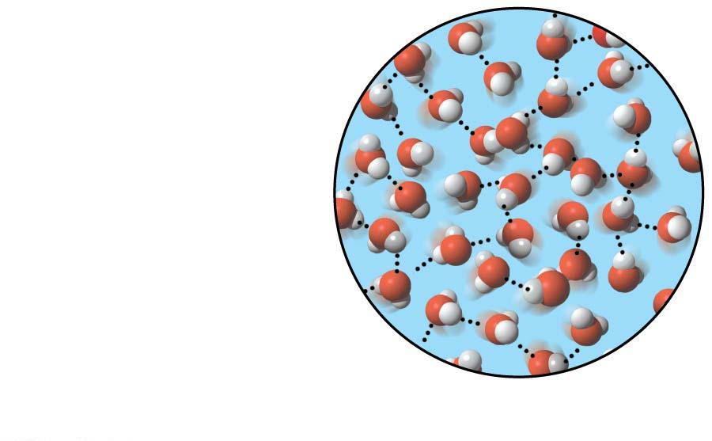
Liquid water
Hydrogen bonds
constantly break
and re-form.
Notes:
Figure 2.UN08 Summary of key concepts: liquid water

Slide 74
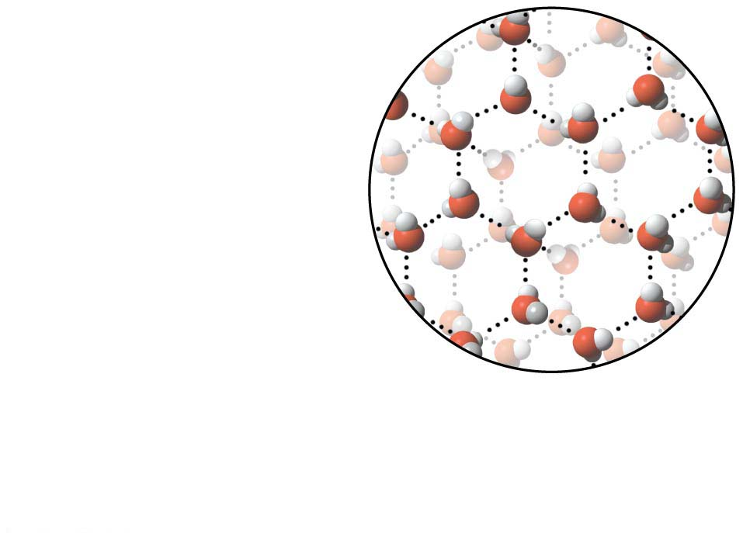
Ice
Stable hydrogen
bonds keep molecules
at a fixed distance
apart, making ice
less dense than water.
Notes:
Figure 2.UN09 Summary of key concepts: ice

Slide 75
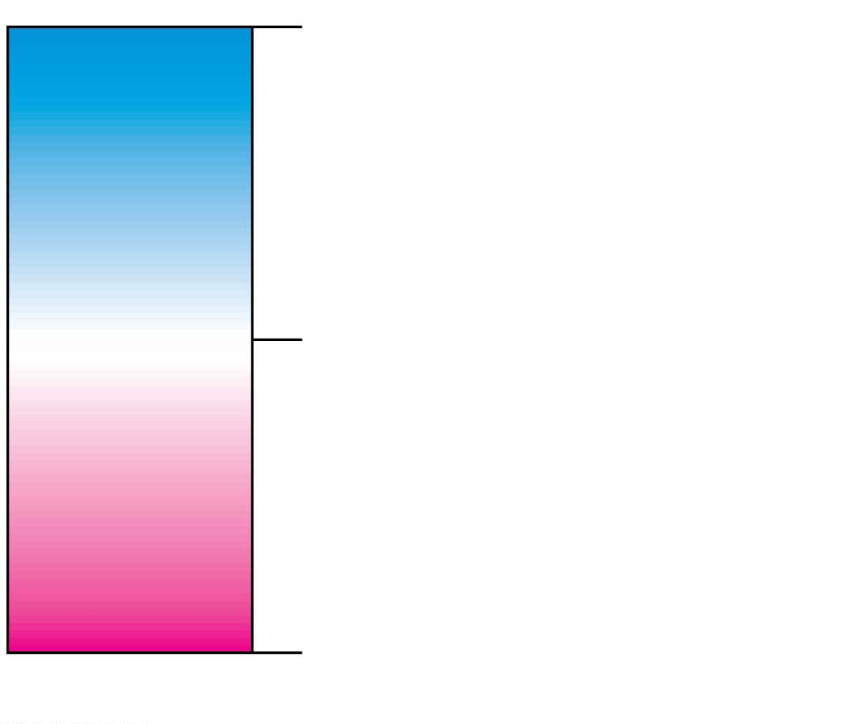
pH 14
Basic
Lower H⁺
concentration
Neutral
pH 7 H⁺ concentration equal
[H⁺] = [OH⁻]
to OH⁻ concentration
Greater H⁺
concentration
Acidic
pH 0
pH scale
Notes:
Figure 2.UN10 Summary of key concepts: acids, bases and pH

Slide 76
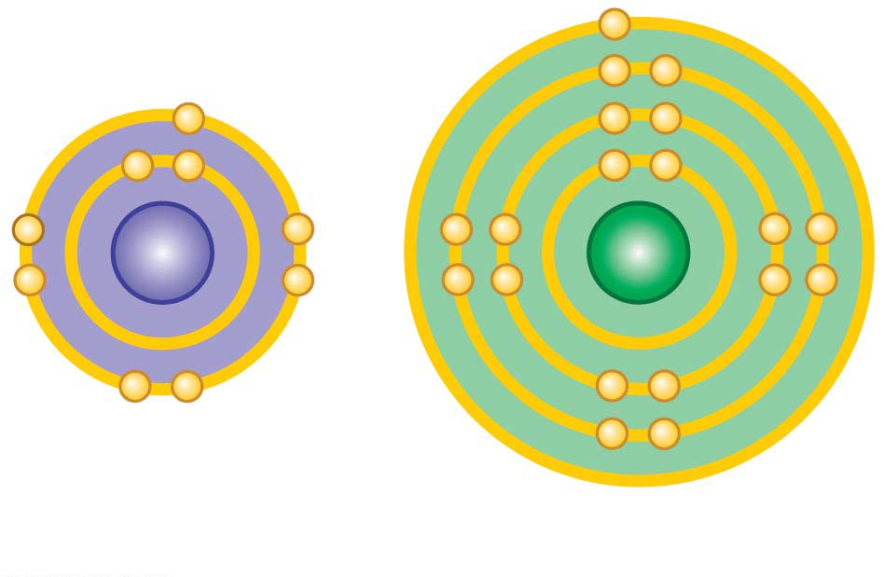
F
K
Fluorine atom
Potassium atom
Notes:
Figure 2.UN11 Process of science, question 13 (bond prediction)

